Slide 1
Lecture 3: Informed Search

Slide 2
Search
Search problem:
States (configurations of the world)
Initial state
Actions and costs
Transition model (Successor function describing world dynamics)
Goal test
Search algorithms:
Systematically builds a search tree
Chooses an ordering of the frontier
Optimal: finds least path cost solution

Slide 3
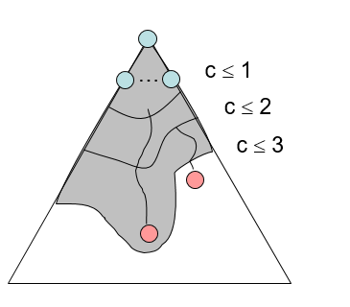
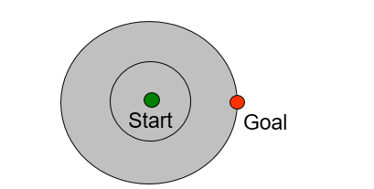
Uniform cost Search
Strategy: expand the lowest path cost
Advantages:
UCS is complete and optimal!
Problems:
Explores options in every “direction”
No information about goal location

Slide 4

Video of Demo Contours UCS

Slide 5
Video of Demo Contours UCS Pacman Small Maze

Slide 6

Informed Search
Informed search uses problem-specific knowledge beyond the definition of the problem itself, so it can find solutions more efficiently than uninformed search.
Problem-specific knowledge beyond the definition of the problem itself is represented using heuristic functions.
Informed Search algorithms:
Greedy best-first search
Astar (A*) search

Slide 7
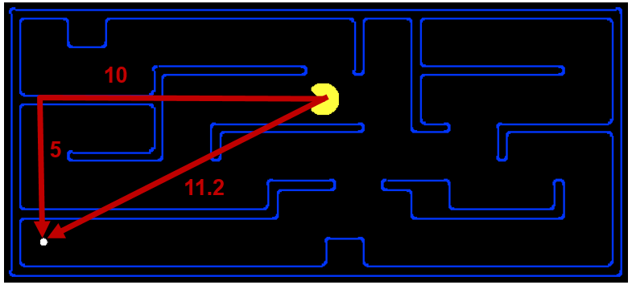
Search Heuristics
A heuristic function h(n) is:
A function that estimates how close a state is to a goal
h(n) = estimated cost of the cheapest path from the state at node n to a goal state.
Designed for a particular search problem.
Examples for Pacman pathing problem: Manhattan distance and Euclidean distance.
Notes:
Function takes a state, returns a number.
Not everyday term. Not “Look both ways before you cross the street”
How far I am? Could run search, but that defeats the purpose!
Not perfect, but something!

Slide 8
Example: Heuristic Function
h(x)
Notes:
Another heuristic. Straight line distance (as the crow flies; not as the snail crawls). Better close to Bucharest.
Not always distances, but that’s easiest to understand.
What do you do with it?

Slide 9
Greedy best-first search
Expand the node that seems closest to the goal, on the grounds that this is likely to lead to a solution quickly. Thus, it evaluates nodes only using the heuristic function h(n).
Do you think that geedy best-first search is optimal? Why?
Notes:
Numbers of heuristic, since that’s what greedy cares about.
Got to Bucharest, but not by shortest path.
End up with some kind of goal, but not what you want. You get a smelly shoe instead of to the airport on time.

Slide 10
Example: Heuristic Function
h(x)

Slide 11

Greedy best first tree search: Example
Is it optimal?
No. Resulting path to Bucharest is not the shortest!
Notes:
Numbers of heuristic, since that’s what greedy cares about.
Got to Bucharest, but not by shortest path.
End up with some kind of goal, but not what you want.
Arad sibiui Rimnicu Vilcea and Pitesti Bucharest
Fagaras has more past cost than Rimnicu Vilcea .
So, the greedy search does not consider the actual cost of the path, it just considers the heuristic.

Slide 12
Greedy best-first Search
Greedy best-first tree search is also incomplete even in a finite state space, much like
depth-first search.
Example: Go from Iasi to Fagaras.
The heuristic function (straight line distance)
suggests that Neamt is closer to the goal,
but it is a dead end.
Greedy best-first graph search is complete in finite state spaces, but not in infinite ones.
Dead end

Slide 13
Greedy best-first Search
The worst-case time and space complexity for the tree version is O(b^{m}), where m is the maximum depth of the search space.
Using a good heuristic function can substantially reduce the complexity.
The amount of the reduction depends on the particular problem and on the quality of the heuristic.

Slide 14
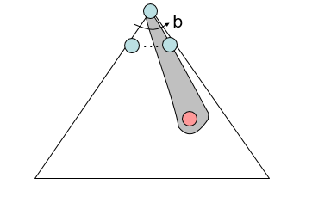
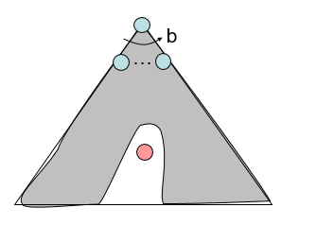
Greedy best-first Search
Strategy: expand a node that seems to be closest to a goal state
Heuristic: estimate of distance to nearest goal for each state
A common case:
Best-first takes you straight to the (wrong) goal
Worst-case: like a badly-guided DFS
Notes:
For any search problem, you know the goal. Now, you have an idea of how far away you are from the goal.

Slide 15
Video of Demo Contours Greedy- straight line distance heuristic
Notes:
Heuristic is straight line distance

Slide 16
Video of Demo Contours Greedy (Pacman Small Maze)-Manhattan distance heuristic
Notes:
Which heuristic function is used?
Manhattan distance

Slide 17



A* Search
UCS
Greedy
A*
Notes:
Notes: these images licensed from iStockphoto for UC Berkeley use.
UCS / Greedy
Goal: The thing that should not be! Hedge bets, be directed.

Slide 18
A* Search
A* search minimizes the total estimated solution cost f(n).
f(n) = g(n) + h(n)
g(n): the actual path cost from the initial state to state n. (backward cost)
h(n): the estimated heuristic function from the node n to the goal. (forward estimated cost)
Thus, f(n) = estimated cost of the cheapest solution through n .

Slide 19
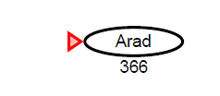
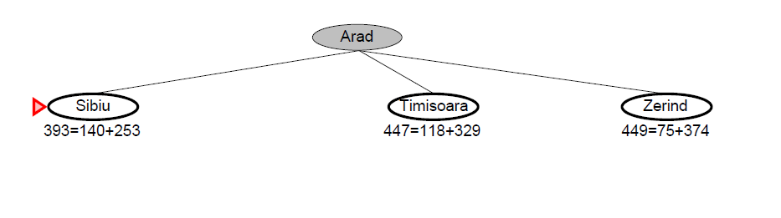
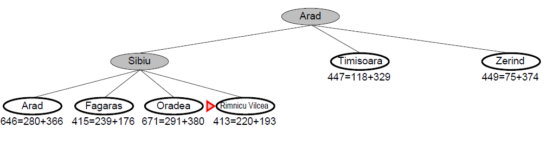
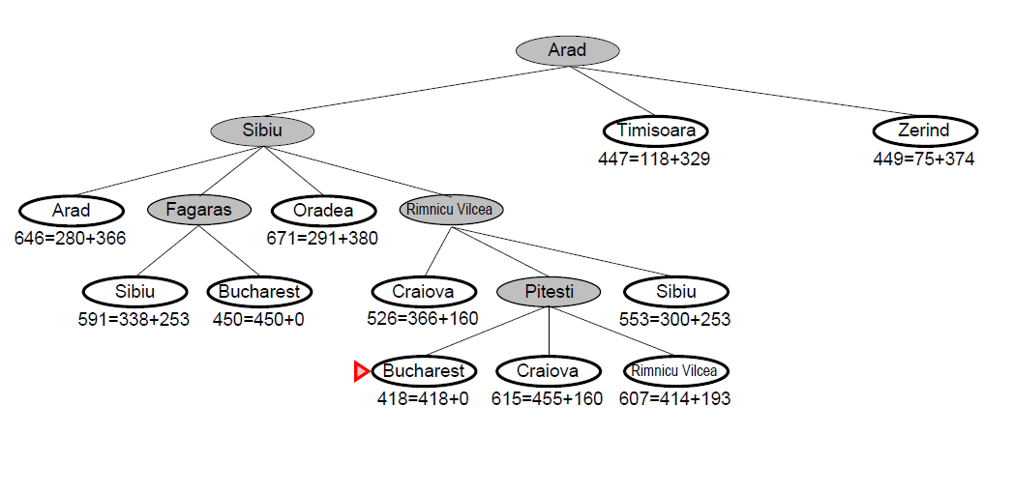
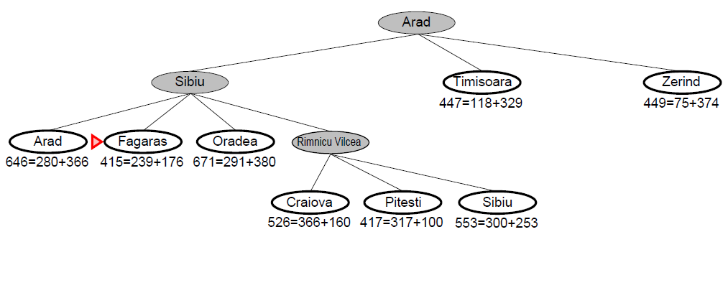
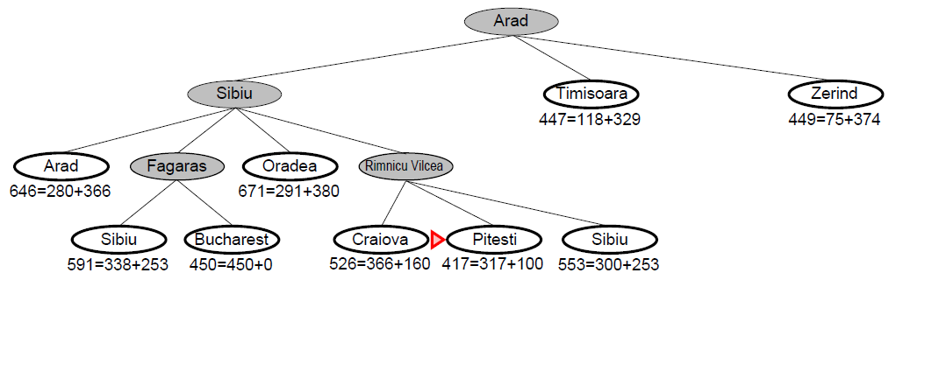
A*search- Romanian Map Example

Slide 20
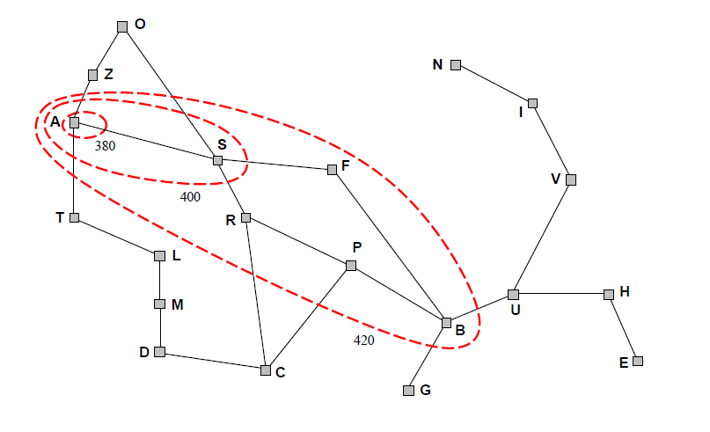
A* Search Contours
Figure 3.25 ap of Romania showing contours at f=380, f=400 and f=420, with Arad as the start state. Nodes inside a given contour have f-costs lower than the contour value.

Slide 21
A* Search- Example 2
Uniform-cost orders by path cost, or backward cost g(n)
Greedy orders by goal proximity, or forward cost h(n)
A* Search orders by the sum: f(n) = g(n) + h(n)
8
g = 0 h=6
S
e
h=1
g = 1 h=5
a
1
1
3
2
g = 2 h=6
g = 9 h=1
S
a
d
G
b
d
g = 4 h=2
e
h=6
1
h=5
h=2
h=0
1
g = 3 h=7
g = 6 h=0
g = 10 h=2
c
b
c
G
d
h=7
h=6
g = 12 h=0
G
Example: Teg Grenager
Notes:
UCS. Cumulative cost of arcs back to root. backward cost g(n). Computed as you go as part of the fringe.
Greedy. Heuristic forward cost h(n). NOT cumulative. Just a function of the state.
What is A*. Sum of the two! Doesn’t go to c early cuz h is high (far from goal).
Doesn’t do a->e branch g is high (expensive).

Slide 22
UCS vs A* Contours
Uniform-cost expands equally in all “directions”
A* expands mainly toward the goal, but does hedge its bets to ensure optimality
Start
Goal
Start
Goal

Slide 23
Video of Demo Contours (Empty) -- UCS
Notes:
Uniform ignores where goal is until you hit it.

Slide 24
Video of Demo Contours (Empty) -- Greedy
Notes:
Goes right there! Fast.

Slide 25
Video of Demo Contours (Empty) – A*
Notes:
Splits the diff.
Heuristic leave open possibility that you’ve gone in the wrong direction.
Maybe going to left has a really, really low cost. Wormhole.
How much trade off is a function of the heuristic. If 0, UCS.

Slide 26
Video of Demo Contours (Pacman Small Maze) – A*
Notes:
Same thing, more complex problem.
Search in ”wrong” direction because heuristic wants to go towards goal.
But find the shortest eventually.

Slide 27
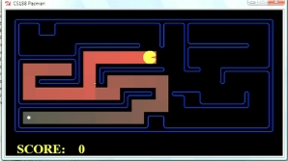
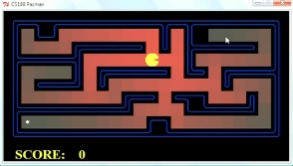
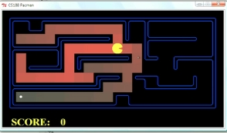
Comparison
Greedy
Uniform Cost
A*

Slide 28
A* Search Properties
A* search is complete.
A* tree-search version is optimal if h(n) is admissible, while the graph-search version is optimal if h(n) is consistent.

Slide 29
When should A* terminate?
Should we stop when we insert a goal to the frontier?
Note : only stop when we dequeue (pick the node for expansion) a goal.
h = 2
g h +
A
2
2
S 0 3 3
S
h = 3
h = 0
G
S->A 2 2 4
S->B 2 1 3
2
B
3
S->B->G 5 0 5
h = 1
S->A->G 4 0 4

Slide 30
Is A* Optimal?
h = 6
1
A
3
g h +
S 0 7 7
S
h = 7
G
h = 0
S->A 1 6 7
S->G 5 0 5
5
What went wrong?
Actual goal cost < estimated goal cost
We need estimates to be less than actual costs!
Notes:
Dequeue a goal state, got the wrong answer.
Abandon all hope! Heuristic is too high. Overestimated actual cost 3.

Slide 31
A* search optimality
A* tree-search version is optimal if h(n) is admissible, while the graph-search version is optimal if h(n) is consistent.
An admissible heuristic never overestimates the cost to reach the goal.
g(n): the actual cost to reach n along the current path
f(n)=g(n) + h(n)
For admissible heuristics, f(n) never overestimates the true cost of a solution along the current path through n.
Admissible heuristics are optimistic because they think the cost of solving the problem is less than it actually is.

Slide 32
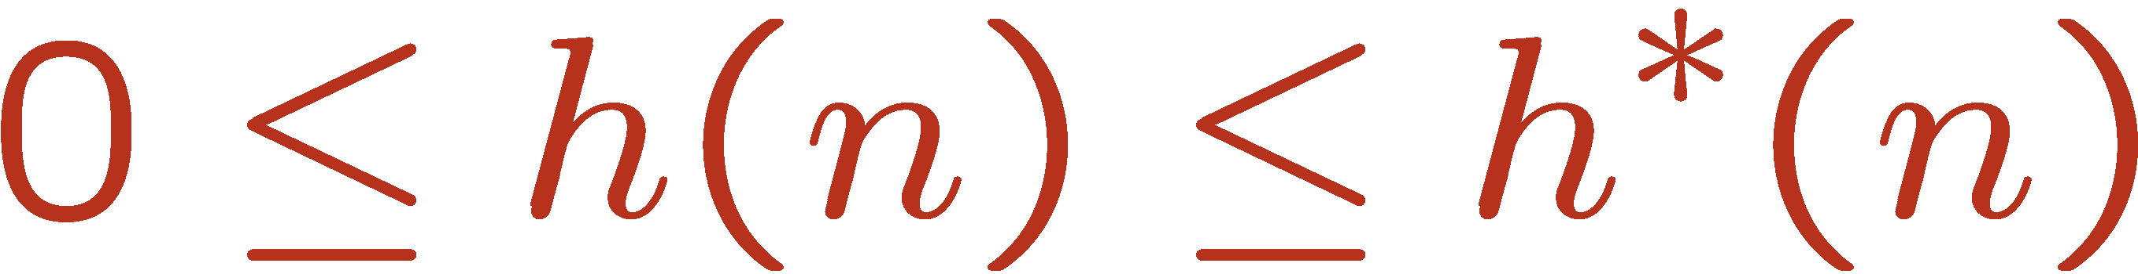
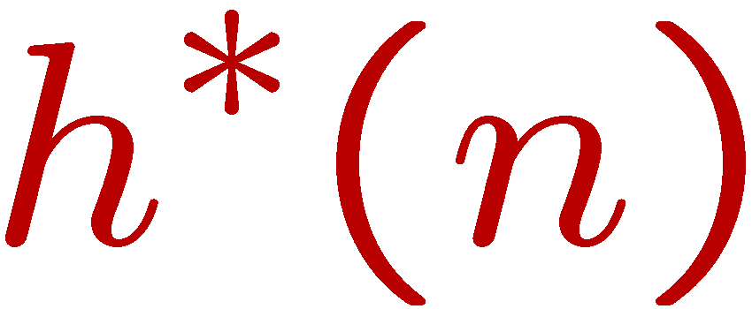
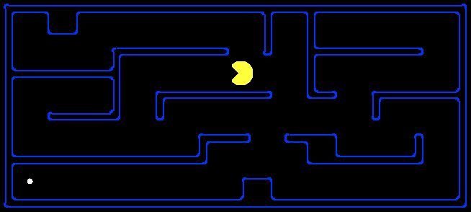
Admissible Heuristics
A heuristic h is admissible (optimistic) if:
where is the true cost to a nearest goal
Example: Euclidean distance
11.5

Slide 33


Optimality of A* Tree Search
Assume:
A is an optimal goal node
B is a suboptimal goal node
h is admissible
Claim:
A will exit the frontier before B
…

Slide 34

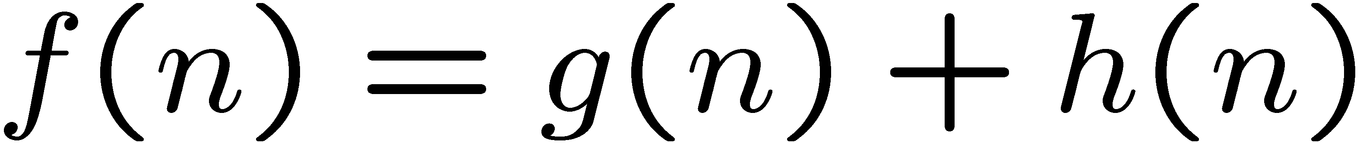
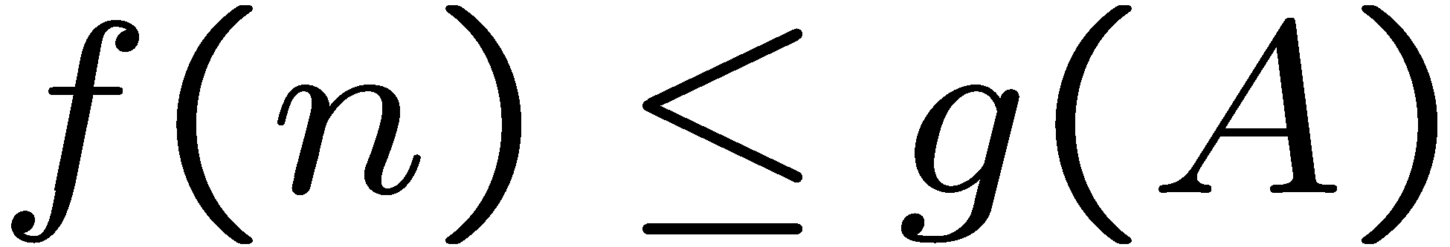
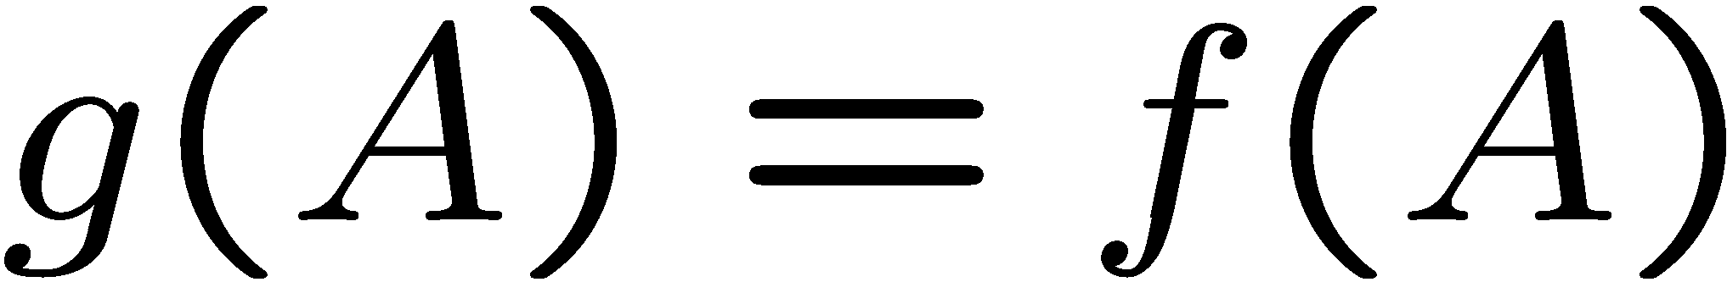
Optimality of A* Tree Search
Proof:
Imagine B is on the frontier
Some ancestor n of A is on the frontier, too (maybe A!)
Claim: n will be expanded before B
f(n) is less or equal to f(A)
…
Definition of f-cost
Admissibility of h
h = 0 at a goal

Slide 35
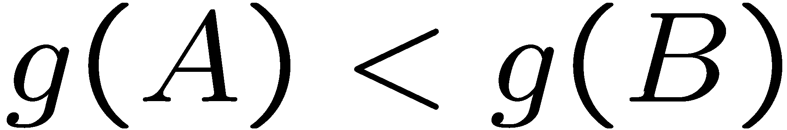
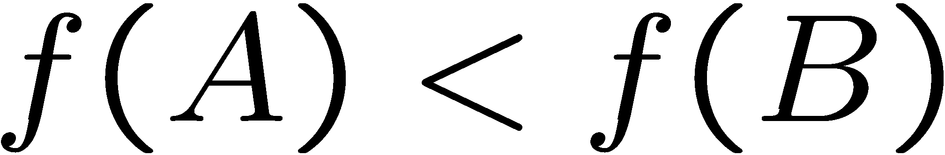
Optimality of A* Tree Search
Proof:
Imagine B is on the frontier
Some ancestor n of A is on the frontier, too (maybe A!)
Claim: n will be expanded before B
f(n) is less or equal to f(A)
f(A) is less than f(B)
…
B is suboptimal
h = 0 at a goal

Slide 36

Optimality of A* Tree Search
Proof:
Imagine B is on the frontier
Some ancestor n of A is on the frontier, too (maybe A!)
Claim: n will be expanded before B
f(n) is less or equal to f(A)
f(A) is less than f(B)
n expands before B
All ancestors of A expand before B
A expands before B
A* search is optimal
…

Slide 37
Creating Admissible Heuristics
Most of the work in solving hard search problems optimally is in coming up with admissible heuristics
Often, admissible heuristics are solutions to relaxed problems, where new actions are available
366
Notes:
Change problem – same or easier. And cheaper.
Imagine a new direct road.
Walk through walls spell.
Inadmissible – a little bit suboptimal is okay.

Slide 38
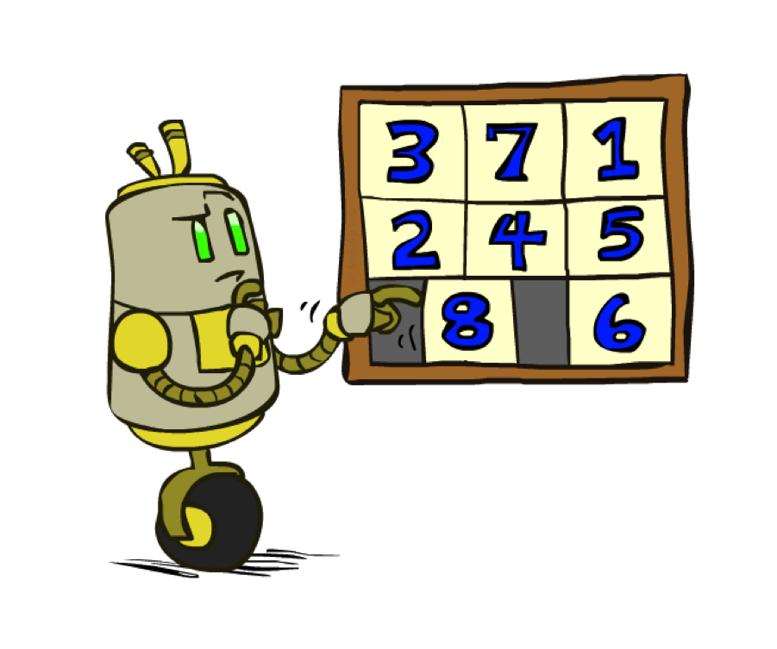
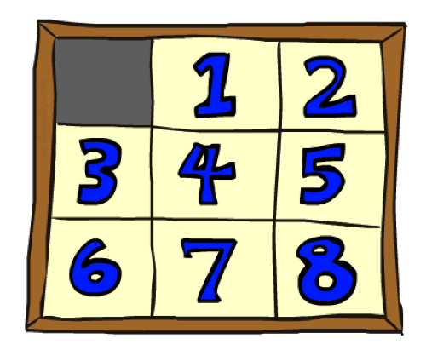
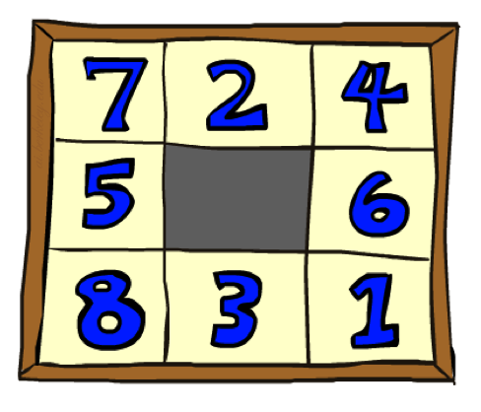
Example: 8 Puzzle
Start State
Actions
Goal State
What are the states?
How many states?
What are the actions?
How many successors from the start state?
What should the costs be?
Admissible
heuristics?
Notes:
Like the xbox of my time.
Branching factor.

Slide 39
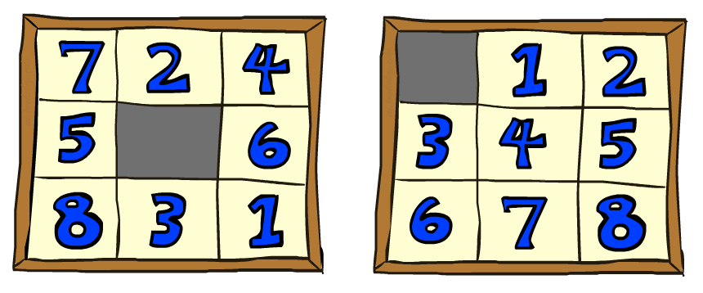

8 Puzzle I
Heuristic: Number of misplaced tiles
Why is it admissible?
h(start) =
This is a relaxed-problem heuristic
8
Start State
Goal State
 | Average nodes expanded when the optimal path has…
 | …4 steps | …8 steps | …12 steps
UCS | 112 | 6,300 | 3.6 x 10⁶
TILES | 13 | 39 | 227
Statistics from Andrew Moore
Notes:
All are out of position. 8
Each tile either goes into it’s right position or not. Fix one mistake, never more than 1.
Cheating is easier.

Slide 40
8 Puzzle II
Heuristic 2: The sum of the distances of the tiles from their goal positions. Because tiles cannot move along diagonals, the distance we will count is the sum of the horizontal and vertical distances.
This is sometimes called the city block distance or Manhattan distance.
Is it admissible?
h(start) =
Start State
Goal State
 | Average nodes expanded when the optimal path has…
 | …4 steps | …8 steps | …12 steps
TILES | 13 | 39 | 227
MANHATTAN | 12 | 25 | 73
3 + 1 + 2 + … = 18
Notes:
Another relaxation, but “harder” than previous.
Lower bound.
Show it’s relaxed or prove.
At LEAST 18 away.
As heuristic gets close to the true cost, you do less search.

Slide 41
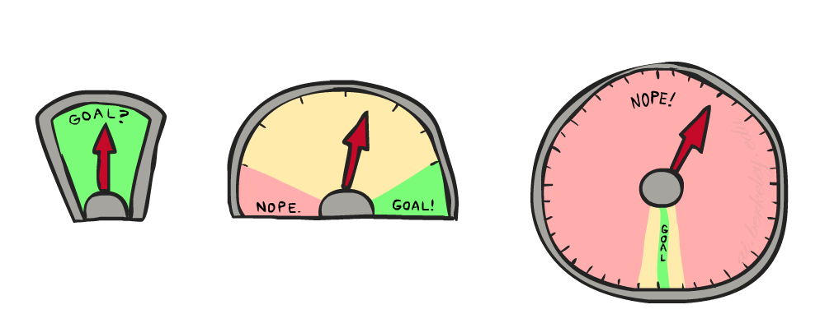
8 Puzzle III
How about using the actual cost as a heuristic?
Would it be admissible?
Would we save on nodes expanded?
What’s wrong with it?
With A*: a trade-off between quality of estimate and work per node
As heuristics get closer to the true cost, you will expand fewer nodes but usually do more work per node to compute the heuristic itself

Slide 42







Dominance of heuristics
Dominance: h_{a} ≥ h_{c} if
Heuristics form a semi-lattice:
Max of admissible heuristics is admissible
Trivial heuristics
Bottom of lattice is the zero heuristic (what does this give us?)
Top of lattice is the exact heuristic
Notes:
Semi-lattice: x <= y <-> x = x ^ y

Slide 43
Learning heuristics from experience
“Experience” here means solving lots of 8-puzzles.
Each optimal solution to an 8-puzzle problem provides examples from which h(n) can be learned.
Each example consists of a state from the solution path and the actual cost of the solution from that point.
From these examples, a learning algorithm can be used to construct a function h(n) that can (with luck) predict solution costs for other states that arise during search.
For example, h(n) can be represented as a linear combination of features as follows:
h(n)= c1x1(n) + c2x2(n) .
x1 is the number of misplaced tiles and x2 is the number of pairs of adjacent tiles that are not adjacent in the goal state.
The constants c1 and c2 are adjusted to give the best fit to the actual data on solution costs.

Slide 44
A* Graph Search Gone Wrong?
State space graph
Search tree
A
S (0+2)
1
S
1
C
h=4
A (1+4)
B (1+1)
h=1
h=2
1
2
C (2+1)
C (3+1)
B
3
Already in the explored set (Do not expand!)
G (6+0)
h=1
G
h=0
Explored Set:
S
B
C
A
Notes:
Need heuristic. This is specification of our abstract problem.
Refuse to expand. Only thing left on fringe is bad G.
Admissible, but not optimal.
If we weren’t doing graph, good G would have appeared, won over bad G.
C used up at the wrong time,

Slide 45
Consistency of Heuristics
Main idea: estimated heuristic costs ≤ actual costs
Admissibility: heuristic cost ≤ actual cost to goal
h(A) ≤ actual cost from A to G
Consistency: heuristic “arc” cost ≤ actual cost for each arc
h(A) – h(C) ≤ cost(A to C)
Consequences of consistency:
The f value along a path never decreases
h(A) ≤ cost(A to C) + h(C)
A* graph search is optimal
A
1
C
h=4
h=1
h=2
3
G
Notes:
Need stronger condition than admisibility.
Single arc. Heuristic don’t score arcs, so take difference.

Slide 46
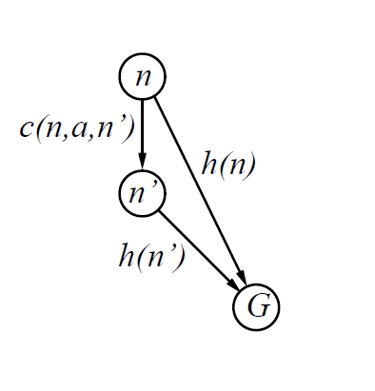
Optimality of A* Graph Search
The A* graph-search is optimal if h(n) is consistent.
If h(n) is consistent:
h(n) ≤ c(n; a; n’) + h(n’)
If h is consistent, we have:
f(n’) = g(n’) + h(n’)
= g(n) + c(n; a; n’) + h(n’) as g(n’)=g(n)+c(n;a;n’)
>=g(n) + h(n) since h(n) is consistent
Then, f(n’)>= f(n)
Accordingly, the values of f(n) along any path are nondecreasing.
Notes:
every node n and every successor n’
of n generated by any action a,

Slide 47
Optimality of A* Graph Search
Sketch: consider what A* does with a consistent heuristic:
Fact 1: In tree search, A* expands nodes in non-decreasing total f value (f-contours)
Fact 2: For every state s, nodes that reach s optimally are expanded before nodes that reach s suboptimally
Result: A* graph search is optimal
…
f ≤ 1
f ≤ 2
f ≤ 3
Notes:
whenever A∗ selects a node n for expansion, the optimal path
to that node has been found.
because f is nondecreasing along any path, n
would have lower f-cost than n
and would have been selected first.

Slide 48


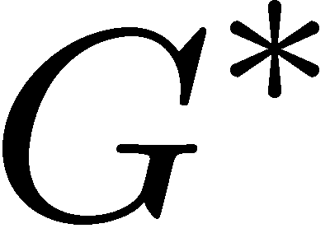

Optimality of A* Graph Search
Fact2 Proof:
New possible problem: some n on path to G* isn’t in queue when we need it, because some worse n’ for the same state dequeued and expanded first (disaster!)
Take the highest such n in tree
Let p be the ancestor of n that was on the queue when n’ was popped
f(p) < f(n) because of consistency
f(n) < f(n’) because n’ is suboptimal
p would have been expanded before n’
Contradiction!

Slide 49
Optimality
Tree search:
A* is optimal if heuristic is admissible
UCS is a special case (h = 0)
Graph search:
A* optimal if heuristic is consistent
UCS optimal (h = 0 is consistent)
Consistency implies admissibility
In general, most natural admissible heuristics tend to be consistent, especially if from relaxed problems

Slide 50
Optimality of A* Search
With a admissible heuristic, Tree A* is optimal.
With a consistent heuristic, Graph A* is optimal.

Slide 51

A* Search Complexity
The number of states within the goal contour search space is still exponential in the length of the solution.
For constant step costs, we can write this as O(b ^{ε d}), where d is the solution depth and ε is the relative error of the heuristic function.
A* keeps all generated nodes in memory, so it has a space complexity problem.
So, A* has exponential time and space complexity.

Slide 52
Memory-bounded heuristic search
The simplest way to reduce memory requirements for A∗ is to adapt the idea of iterative
deepening to the heuristic search context, resulting in the iterative-deepening A∗ (IDA ∗) algorithm.
The main difference between IDA ∗ and the standard iterative deepening is that the cutoff
used is the f-cost (g+h) rather than the depth; at each iteration, the cutoff value is the smallest
f-cost of any node that exceeded the cutoff on the previous iteration.

Slide 53

A*: Summary
A* uses both backward costs and (estimates of) forward costs
A* is optimal with admissible / consistent heuristics
Heuristic design is key: often use relaxed problems

Slide 54
A* Applications
Video games
Pathing / routing problems
Resource planning problems
Robot motion planning
Language analysis
Machine translation
Speech recognition
…

Slide 55
Summary
Heuristic (Informed Search)
Greedy search
A* search
Heuristic functions
Admissible heuristics
Consistent heuristics
Optimality of A* search
Complexity of A* search

